Slide 1

NoSQL Databases
Final Project

Slide 2

MongoDB

Slide 3
MongoDB – (Insertion time: 0.o270 Seconds)
Great general-purpose NoSQL DB with good horizontal scaling via sharding
Horizontal Scaling: Yes via Sharding. MongoDB supports auto-sharding, which distributes data across multiple servers (shards). Each shard holds a subset of the data and acts as an independent database.
Vertical Scaling: Yes. MongoDB can run on more powerful machines (CPU, RAM) to handle increased load.
Strength: Schema-less JSON-like structure, Great for agile and fast-changing data models
Weakness: Less suited for complex transactions, Joins can be inefficient (though $lookup exists)
Real world Example: Forbes: CMS and digital publishing

Slide 4
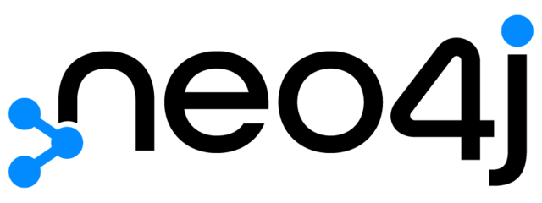
Neo4j

Slide 5
NEO4j – (Insertion time: 9.894041 Seconds)
Best for graph-based queries, not ideal for large-scale horizontal writes.
Horizontal Scaling: Limited. Native Neo4j Community Edition is not horizontally scalable. Enterprise Edition supports Causal Clustering for scaling reads and availability, but not seamless write scaling.
Vertical Scaling: Yes. Neo4j can utilize more powerful hardware (RAM, SSDs, CPU) to handle larger graphs.
Strength: Native graph database, Optimized for relationships and traversals
Weakness: Not ideal for general-purpose storage, Requires graph modeling mindset
Real world Example: eBay: Dynamic search recommendations

Slide 6
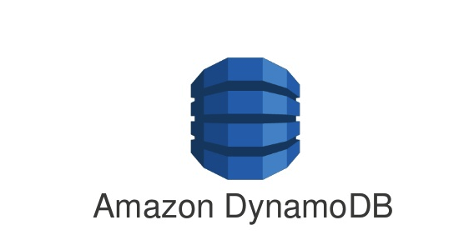
AWS DYNAMODB

Slide 7
AWS DYNAMODB – (Insertion time: 30.4528 Seconds)
Highly scalable, serverless, best suited for high-throughput apps needing predictable performance.
Horizontal Scaling: Yes. DynamoDB is fully managed and automatically scales horizontally based on throughput and data volume. Uses partitioning under the hood
Vertical Scaling: Not applicable directly — scaling is handled through provisioned throughput or on-demand settings, not by resizing servers.
Strength: Built-in high availability and durability, Fast performance with predictable latency
Weakness: Learning curve for data modeling (partitioning, indexes), Write throughput limitations without optimization
Real world Example: Netflix: Metadata and playback info

Slide 8

Google BigTable

Slide 9
GooGLE Bigtable – (Insertion time: 26.3094 Seconds)
Extremely scalable for analytical and time-series workloads
Horizontal Scaling: Yes. Bigtable automatically scales horizontally across thousands of nodes. Data is split into tablets, and each tablet can be served by different nodes
Vertical Scaling: Yes, but less common. You can increase machine resources, but horizontal scaling is preferred and automatic.
Strength: Scalable to petabytes, Integration with GCP ecosystem
Weakness: Limited query flexibility, Complex setup
Real world Example: Snapchat: Activity tracking

Slide 10
Comparision

Slide 11
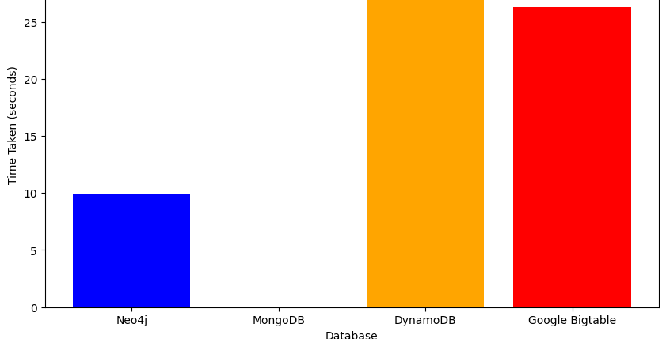

Slide 12
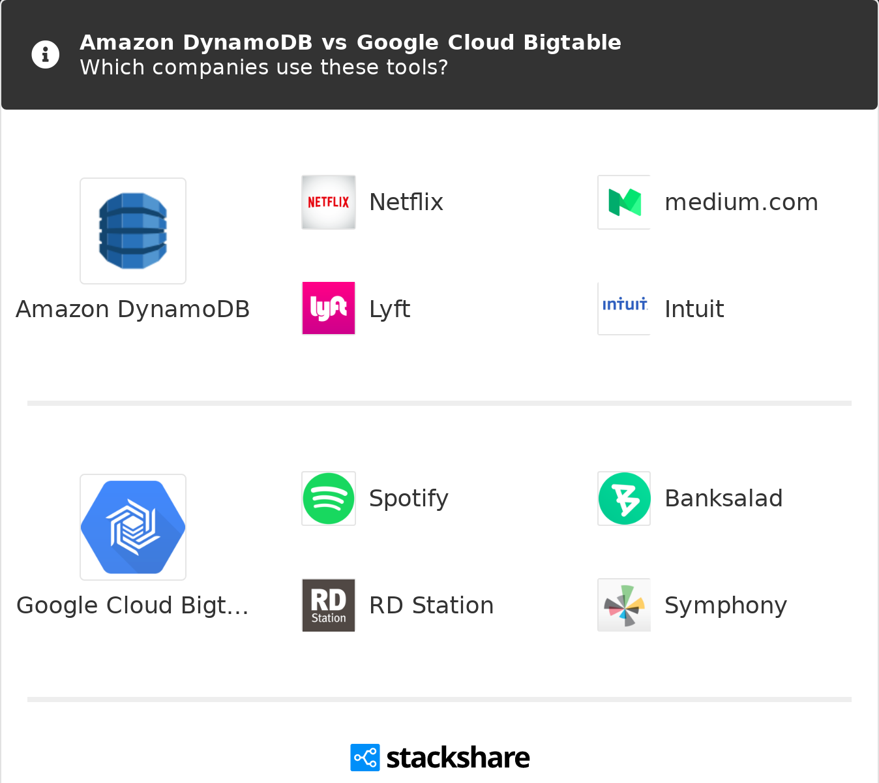
Cloud database – real life example comparision

Slide 13
Links
Github: https://github.com/Kunj-2206/benchmark_databases

Slide 14
Group Members
Kunj Kansara
Bhavin Patel

